Slide 1



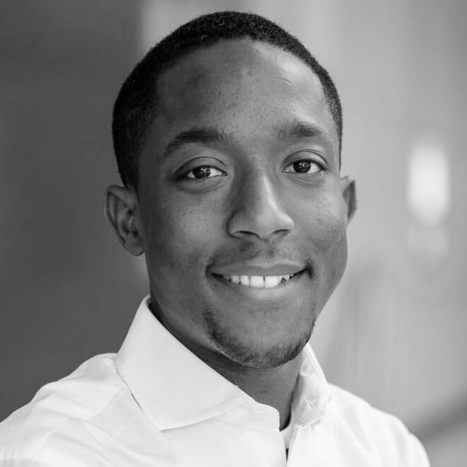

Beau Sackey – Key Expert
Professional experience
Education and skills
Canada: For the 2nd largest Canadian Bank (by assets):
Program Manager for a CAD $180 million Enterprise (Bank wide) Credit Risk Reporting Solution implementation in accordance with global banking regulation from the Basel Committee on Banking Supervision (BCBS 239)
Stood up, led and run a program management office to execute and deliver on the mandatory requirements of the regulation working in tandem with Canadian regulators, Bank’s Risk Committee of the Board and a team of 250+ resources to deliver program on time under significant budgetary, resource and bank legacy constraints
Ghana: Large Pan-African Bank:
Advised my client (a Ghanaian subsidiary of an international bank) on a medium term strategy specifically to achieve significant growth objectives. Client was seeking to grow profit before taxes (PBT) ambitiously, and my team provided a roadmap of specific initiatives across both cost centers and profit centers in order to achieve those goals.
Result: Client within the first year of implementing strategic initiatives exceeded the profit targets set for them based on financial modelling projections and is on course to meet/exceed 5 year profit plan.
Beau has an MBA degree from Queen’s University. He also holds an undergraduate honors degree in Commerce from Carleton University both in Canada
Beau is also a designated PMP (Project Management Professional)
Beau is an Adjunct Professor at Seneca College (York University) where he teaches Advanced Information Technology Project Management
Beau speaks English fluently and is able to have basic conversations in French. He also speaks Ga and Twi fluently
Introduction
Multifaceted leader with 12+ years of project management and management consulting experience across various industries including: banking/finance, telecommunications, manufacturing and retail with deep capabilities in each industry. Successfully led projects, programs and turnarounds of Fortune 500 and other leading companies globally. Excellent communicator and negotiator, who consistently engages and inspires teams to perform and deliver results.
Challenges are opportunities that need to solved. I love tackling high stakes projects, mentoring young colleagues and delivering exceptional results for clients.

